Slide 1
Writing Review
FPMA 1
Strengths and Gaps

Slide 2
Results of FPMA 1 (at a glance)
CLASS | # of LOW | # of MODERATE | # of HIGH
*Period 1 | 2 | 14 | 3
Period 2 | 4 | 18 | 1
Period 3 | 3 | 19 | 2
*Period 4 | 3 | 16 | 3
Period 5 | 1 | 19 | 3
Period 6 | 6 | 15 | 2
LEVEL | RANGE
LOW | 1-4
MODERATE | 5-7
HIGH | 8-10
*Period 1: 1 UNSCOREABLE
*Period 4: 1 UNSCOREABLE

Slide 3
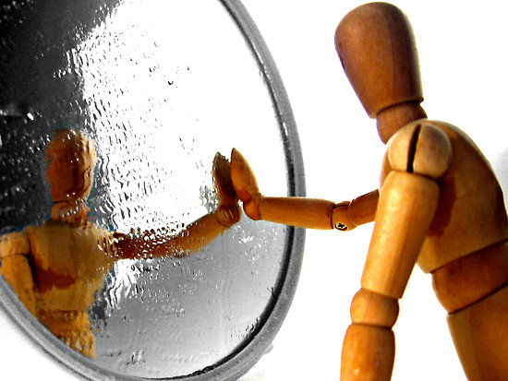
Reflection
After receiving your essay…
Read over what you wrote.
Read over the mini-rubric.
Read over the comments and feedback.
Then, respond to the following questions:
What did you do well?
How could you improve?
How much effort did you put into this?

Slide 4
Strengths: The Good News
Clear Claim
Evidence Selection
Paraphrasing Text
Referencing Sources
Conventions

Slide 5
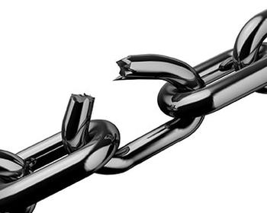
Gaps: The Not-so-good News
Not fully understanding / addressing prompt
“Unoriginal” introductions
Placement of claim in essay
Limited transitions
Addressing counterclaim / counterargument in ignorant manner
Not referencing sources
Types of elaboration

Slide 6
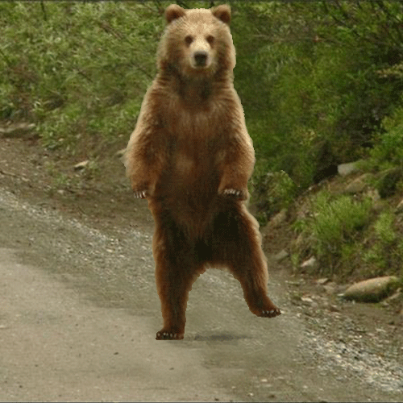
Prompt Breakdown:
Remember CUB and TAP?
C | Circle the purpose.
U | Underline the task.
B | Box the key words.
T | Task – What you should be writing about. (TOPIC)
A | Audience – Who would want to read this?
P | Purpose – Why are you writing this? (MODE) (Inform/explain or argue)
Before Reading
After Reading

Slide 7
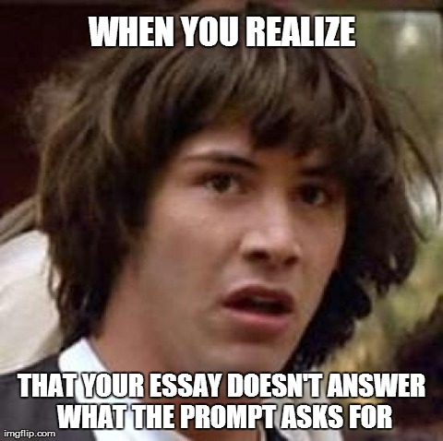
Prompt Breakdown
What is the prompt asking?
Turn the prompt into a question!
Proceed.

Slide 8
“CUB” and “TAP” the Prompt
Write an argument in which you take a stance on which woman you believe the U.S. Treasury should put on the $10 bill when it is released in 2020 and how this might impact having other women on paper currency in the future.

Slide 9
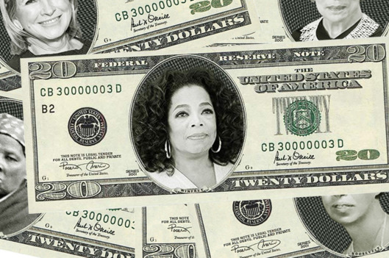
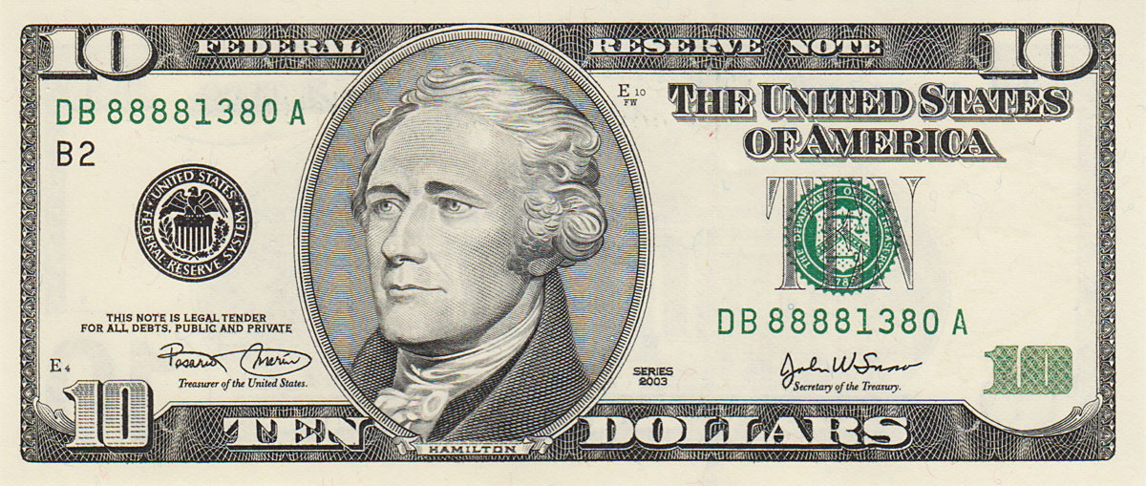
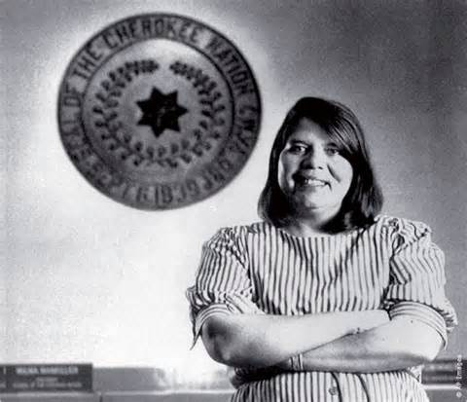
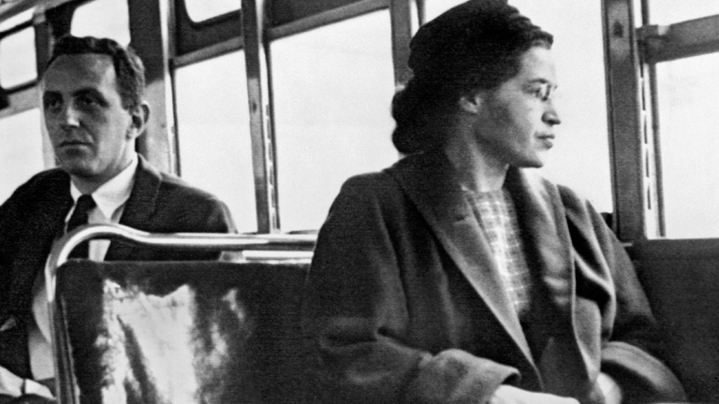
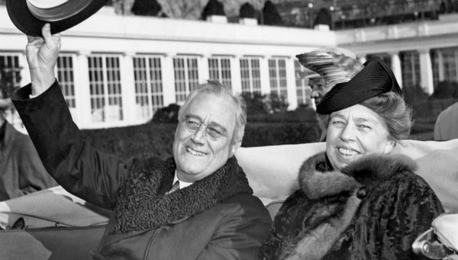
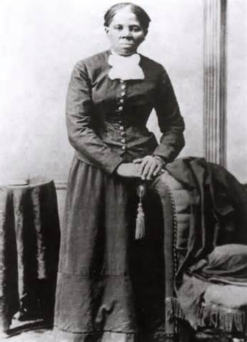
Prompt Breakdown… again… Perhaps you missed something?
Write an argument in which you take a stance on which woman you believe the U.S. Treasury should put on the $10 bill when it is released in 2020 and how this might impact having other women on paper currency in the future.
?
Future?

Slide 10
So… What do you Need to be Successful?

Slide 11
Expectations: Simplified Argumentative Rubric
Purpose, Focus, Organization | Evidence and Elaboration | Conventions
Answers the prompt *Clear claim Beginning, middle, and end *Recognizes opposing viewpoint/side Transitions connect/link ideas together inside and between paragraphs Stays on topic Professional/academic tone | Uses all sources Consistent citations Uses vocabulary that relates to topic and argument Uses different sentence patterns Presents enough evidence that strongly supports claim Commentary/elaboration shows how and why evidence supports claim | Errors do not get in the way of the reader’s understanding of the essay
*For Informative/Explanatory
Replace “claim” with “controlling idea”
Counterclaim not needed

Slide 12
Types of Thesis Statements
Note…
Avoid using “I” even if the prompt asks for your opinion.
What…?
Reveal your specific stance and/or point(s).
A thesis statement should…
“Answer” the prompt.
Be specific.
Two Types:
CLAIM
Argumentative purpose
CONTROLLING IDEA
Explanatory / Informative purpose
Where…?
Put at the very END of your introduction, serving as the LAST SENTENCE.
Then…?
The rest of your paper should include evidence to support your “thesis.”

Slide 13
The Planning Process: P.E.EL.
*Claim / Controlling Idea
Introduction Paragraph
(P)oint¹
(E)vidence
(EL)aboration
(P)oint²
(E)vidence
(EL)aboration
Body Paragraphs
P¹
P²
Conclusion
*Your claim / controlling idea should have multiple POINTS. Meaning, you should have more than just one P.E.EL. plan sheet.

Slide 14
Notable Work: Introductions
In 2020, there will be a new face on the $10 bill – a woman. Not just any woman, but one that has played a major role in the history of America. Harriet Tubman, one of America’s greatest impacts on slavery, should claim the position.
The U.S. Treasury Department has announced that there will be the face of a woman on the new 10 dollar bill. They have narrowed it down to four women. Harriet Tubman, Eleanor Roosevelt, Rosa Parks and Wilma Mankiller. The face of that woman on the bill should be Eleanor Roosevelt.

Slide 15
Introductory Paragraphs
General Topic Information
Lead into Point
Claim or
Controlling Idea

Slide 16
Mr. Frankenstein’s Example: Introduction
Whether due to nostalgic sentiment, or perhaps due to the symbolic significance of the historical figures printed on each note, the U.S. Treasury Department is actually striving to hold onto the past while simultaneously looking toward the future. Thus, a monetary rejuvenation of sorts has commenced, intending to bring the face of a woman to the ten dollar bill. Being a democracy, the people have a say in selecting this esteemed figure. While many women over the course of history are worthy of recognition, Wilma Mankiller deserves this honor due to her contribution to Native American culture, as well as for giving women a voice for years to come.

Slide 17
PROMPT: Use “Cub” and “Tap”
Whether a scary story from the past or a gruesome film on the big screen, common traits help create the horror genre. Write an essay explaining how “The Tell-Tale Heart” is classified as a piece of horror.

Slide 18
TASKs (Day ONE)
Prompt Breakdown
P.E.EL. Plan Sheet
Introductory Paragraph

Slide 19
Peer Critique: Introduction
General Topic Information
Lead into Point
Claim or
Controlling Idea
Swap your introductory paragraph with a peer.
On a slip of paper, respond to the following:
Is the introductory engaging? How/why?
What is the controlling idea?
What are the point(s) of the controlling idea?
Provide ONE positive and ONE “needs improvement.”

Slide 20
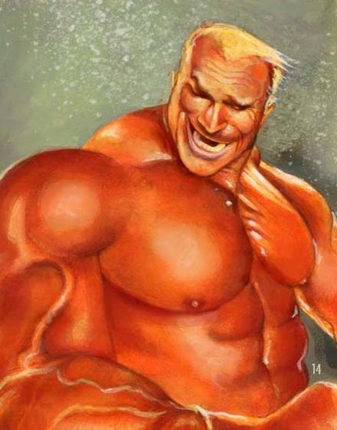
Body Paragraphs:
Bulk of your essay
Focused on point(s)
Developing and connecting ideas
Balance of evidence and elaboration

Slide 21
Notable Work: Body paragraphs
Not only was she the wife of President Franklin Delano Roosevelt, Eleanor was also the first First Lady to take the role of an activist and reach out to the people directly. According to the text, “She took the leading role in addressing the needs of women, children, laborers and minority groups” (Source 2, Paragraph 11). Mrs. Roosevelt was the foundation for so many of the amazing activist groups in the world today. She is one of the women that have impacted America the most; therefore she should be honored in a way that is used by everyone in this country…
Harriet Tubman is a very important figure in history. Her actions heavily impacted the U.S. and will always be remembered. For instance, she helped free many slaves. In paragraph 9, sentence 1, it says, “Tubman escaped slavery and became one the country’s leading slavery-haters before the Civil War.” By escaping slavery, Tubman showed just how much courage and strength she had in order to fight for what she believed. In this case, it was freedom for slaves. Tubman also helped the Union army as a scout. In paragraph 9, it says, “She had a great personal knowledge of the landscape of mountains, hills, and territories of the South. This helped her to become a valuable person to the Union army.” Even though she had already helped fight for freedom, she continued fighting because she knew what was best for her country. She made such an impact in history that without her, the U.S. wouldn’t be what it is today. By putting Harriet Tubman on the $10 bill, everyone will remember her legacy.

Slide 22
Notable Work: Body paragraphs
In the second paragraph of Source 1, it says, “America’s currency makes a statement about who we are and what we stand for as a nation.” The money of America symbolizes our morals and values. A woman being added to the $10 bill would probably encourage the Treasury to add more women to currency who have played a big role. There are many women that are important to this country’s history that will hopefully be recognized in the future. When people see Rosa Parks on the ten dollar bill, it shows that our country doesn’t support segregation in America. There are plenty of women that can symbolize what this country is about.

Slide 23
Mr. Frankenstein’s Example: Body Paragraph
There is no doubt as to why Wilma Mankiller is in the running, being the recipient of the Presidential Medal of Freedom, a highly regarded award. As the “first elected female chief of a Native nation in modern times,” she was an advocate for “extensive community development, self-help, education and healthcare programs” for the Cherokee Nation, bringing both honor and aid to her people (Source 2, Paragraph 15-16). Such a sincere concern for the livelihood of her people—whether regarding finances, education, or mental well-being—exemplifies many of the values on which our great nation was founded. According to Treasury Secretary Jacob J. Lew, “American’s currency makes a statement about who we are and what we stand for as a nation.” Clearly, her life has made a statement, one that is worthy of remembrance.

Slide 24
Mr. Frankenstein’s Example: Body Paragraph
Furthermore, the purpose of reflecting on the past is to ensure a better future. As aforementioned, Wilma Mankiller paved the way for the future with her unprecedented rise to chiefdom as a woman. Before her election as chief, Wilma stated, “Cherokee girls would have never thought that they might grow up and become chief” (Source 2, Paragraph 14). Becoming chief in Native American culture is a major feat in itself. Doing so as a woman, even more so. Her ability to overcome social norms, and essentially change the social norms of Native American culture, shows a world of possibilities for the many women of America and around the world. Her actions illustrate the realm of possibilities for women in the present, as well as the future. Possibilities for women to be commemorated and celebrated on a form of currency. Possibilities to be a conversational piece being passed from hand to hand. A conversational piece not surrounding race, religion, or gender, but rather on their contribution to society.

Slide 25
Structure Check
Complete and respond to the following:
In GREEN, underline the point (topic) of each body paragraph.
In BLUE, underline evidence.
In YELLOW, underline your elaboration or commentary.
COUNT how many sentences are provided for evidence, then for elaboration. Is there a balance?
BOX the first three words of each sentence. Is there a variety of sentence starters and transitions?
CIRCLE any references to sources. Did you use, cite, and punctuate ALL sources correctly?

Slide 26
Notable Work: Conclusion
In conclusion, the best candidate for the revised 10 dollar bill is Wilma Mankiller because of her inspirational acts. But in the future, more women will be preserved in history.
Overall, Eleanor Roosevelt is the best fit. She has done more than impact our country – she has impacted our world. Because of her, others have stepped up and fought for what’s right. She has left a legacy at our disposal that we should choose to recognize.

Slide 27
Conclusion Paragraphs
Rephrase Claim / Controlling Idea
Big Picture
Emphatic Punch

Slide 28
Mr. Frankenstein’s Example: Conclusion
While she may not be known as well as Rosa Parks, who contributed greatly to the Civil Rights movement, or Harriet Tubman, who helped free numerous slaves through the Underground Railroad, Wilma Mankiller has contributed greatly to our nation’s history. Whether folded up in a pocket or exchanged between hands, the face of Wilma Mankiller on the ten dollar bill will serve as a reminder of our nation’s past, but even more so of the bright future that awaits for women to be recognized as a notable piece of our great country.

Slide 29
“The Tell-Tale Heart” Non-Example
“The Tell-Tale Heart” is a part of horror because of its believability. “The Tell-Tale Heart” is told through the eyes of a crazy man. It is told through a first person point of view where the Narrator is the main character. This makes it believable. Sharon Russell states things are horrifying because of “how we come to believe in the events related and how they are explained to us.” Readers of “The Tell-Tale Heart” can almost believe the events of the story because a crazy person murdering someone is possible. She goes on to say, “Often horror has its greatest effect on us because we almost believe… that the events are possible” (Source 1, paragraph 4). The believability is just one reason why “The Tell-Tale Heart” can be classified as a part of the horror genre.
So… what is “wrong” and what is “right” about this?

Slide 30
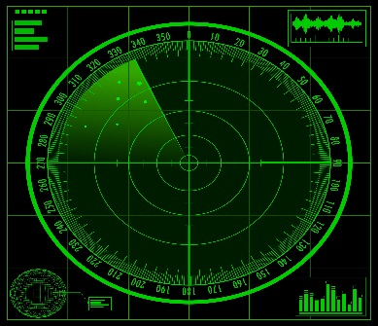
Rad(A)r
REPLACE | ADD | DELETE | REORDER
Words that aren’t specific Overused words Sentences that are unclear | New information Descriptive adjectives and adverbs Relevant evidence Elaboration that links evidence to controlling idea / claim | Unrelated ideas Sentences that may sound good but don’t support controlling idea / claim Unnecessary details Opinionated statements | To enhance the flow To make more sense So details support controlling idea / claim

Slide 31
Rad(A)r: REVISING CONTENT
Swap papers with a peer, and complete the following:
What could you REPLACE?
What could you ADD?
What could you DELETE?
What could you REORDER?
Provide at least ONE positive comment.
Remember, part of feedback is suggesting solutions!

